Slide 1
Chapter 6
Planning the Work Activities
Project Planning

Slide 2
Initial Project Coordination
Early meetings are used to decide on participating in the project
Also used to “flesh out” the nature of the project
Outcomes include:
  Technical scope
  Areas of responsibility
  Delivery dates or budgets noted
  Risk management group created

Slide 3
Initial Project Coordination Continued
Each participant in the project should approve this initial plan
This plan is approved by senior management
Senior management may change…
  Accelerate timetable
  Reduce budget
  Part of budget may be “held back” for contingencies

Slide 4
Outside Clients
When it is for outside clients, specifications cannot be changed without client’s permission
Client may place budget constraints on project
May be competing against other firms

Slide 5
Project Plan Elements
Also called project proposal
Elements similar to general planning components

Slide 6
Project Plan Elements Continued
Overview
Objectives or scope
General approach
Contractual aspects
Schedule Planning
Schedules
Resources
Personnel
Risk management plans
Evaluation methods

Slide 7
Project Plan Elements Continued
Overview
  Short summary of the objectives and scope of the project
  Directed at top management
  Includes objectives, organizational structure, major milestones
Objectives or scope
  More detailed statement of goals
  Includes goals on profit, competition, and technical

Slide 8
Project Plan Elements Continued
General approach
  The managerial and technical approach to the project
  May have a technical section to discuss project technology
  May discuss the use of subcontractors

Slide 9
Project Plan Elements Continued
Contractual aspects
  Reporting requirements
  Customer-supplied resources
  Liaison arrangement
  Advisory committees
  Project review and cancellation
  Proprietary requirements
  Specific management agreements

Slide 10
Project Plan Elements Continued
Schedule planning
    Identify initial high level concept / ideas
      Analyse using a Mind Map, broad review of concept
    Use Work Break Down Structure to add details
      Break down each topic (Work Package) into finer detail as Tasks, subtasks and activities, Action Plan
Scheduling
  Creates lists of when each task will be completed
  Identifies lists of all milestone events
    Important for monitoring and control of projects
  Is the heart of completing the project

Slide 11
Project Plan Elements Continued
Resources
  Budget
    Capital, labor, material, by task
  Cost monitoring and control procedures
Personnel
  Personnel requirements of project
  Skills are listed rather than people
  May include “time phasing” of requirements

Slide 12
Project Plan Elements Continued
Risk management
  Problems and lucky breaks
Evaluation methods
  What will be measured and monitored
  How the data will be collected and stored
  How the project will be evaluated

Slide 13
Systems Integration / Evaluation
Performance
Quality / Effectiveness
Cost
Customer Satisfaction

Slide 14
The Project Action Plan
What is to be done?
When it is to be started and finished?
Who is going to do it?

Slide 15
The Action Plan Continued
Activities on a project face unique complexities
  Some activities cannot start until others are finished
  Some activities must be done at-the-same-time
  Some activities are very time critical
  Others have a great deal of flexibility
Knowing all this requires a great deal of planning

Slide 16
The Project Planning Process
To create a detailed action plan start with the Project Brief
Consider and analyse the brief
Identify initial high level concept (ideas)
  Analyse using a Mind Map
  Broad review of concept
Add details to each topic identified in Map
  Break down each topic (Work Package) into finer detail as Tasks, subtasks and activities

Slide 17
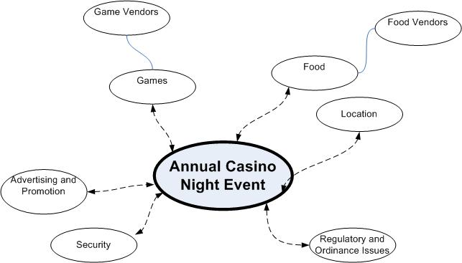
1. Develop a Mind Map

Slide 18
2. Hierarchical Planning
From Mind Map identify Major Tasks
Major tasks / Work Packages are listed
Each major task is then broken down into more detail
This continues until all the activities of each task to be completed are listed
Need to know which activities “depend on” other activities

Slide 19
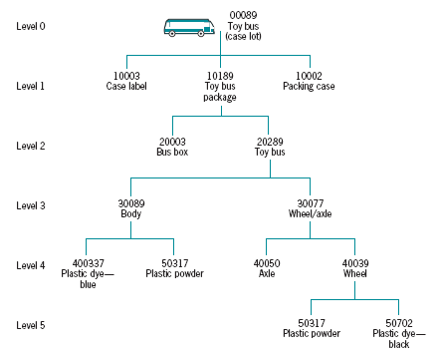
A Tree-Based Plan
Figure 6-4

Slide 20
The Work Breakdown Structure
A product-oriented family tree subdivision of hardware, services, and data required to produce the end product
Breaks tasks down into successively finer levels of detail, subtasks and activities
Continues until all meaningful tasks or work packages have been identified

Slide 21
The Work Breakdown Structure Continued
These smaller elements make tracking the work easier
Need separate budget/schedule for each task or work package
Easier to identify costs when considering smaller elements

Slide 22
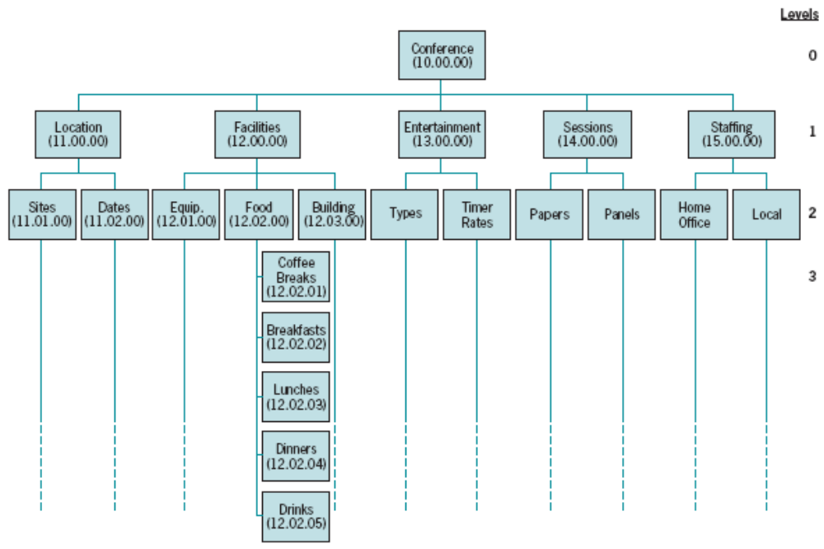
WBS: Hierarchy Chart View
Figure 6-6

Slide 23
3. Steps to Create an Action plan
List the task breakdown in successive levels, use Work Breakdown Structure
Identify data for each work package
Review work package information
Cost the work packages
Schedule the work packages
Continually examine actual resource use
Continually examine schedule

Slide 24
WBS to Action Plan
Use the Work Breakdown Structure as the guide
Take activities from WBS to create the Action Plan
The Action Plan adds time and people
  ONE PERSON ONE ACTIVITY
  Makes scheduling Easy

Slide 25
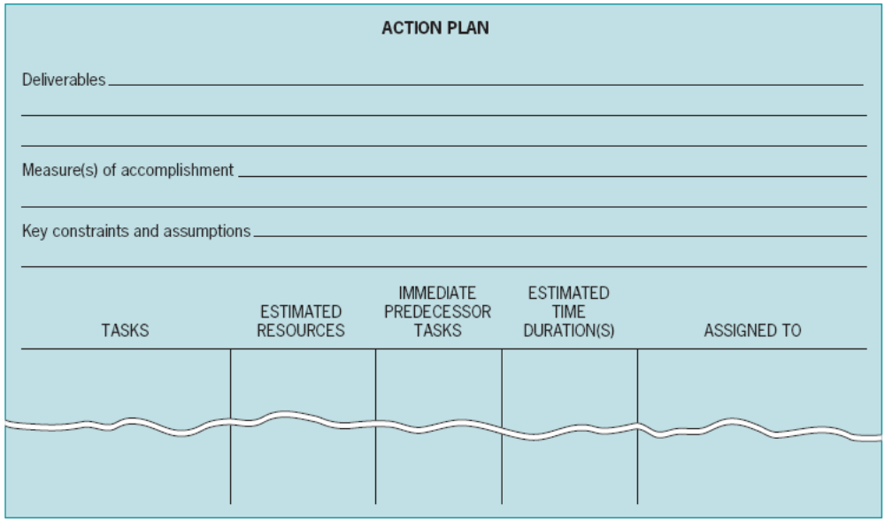
A Form to Assist Planning
Figure 6-2

Slide 26
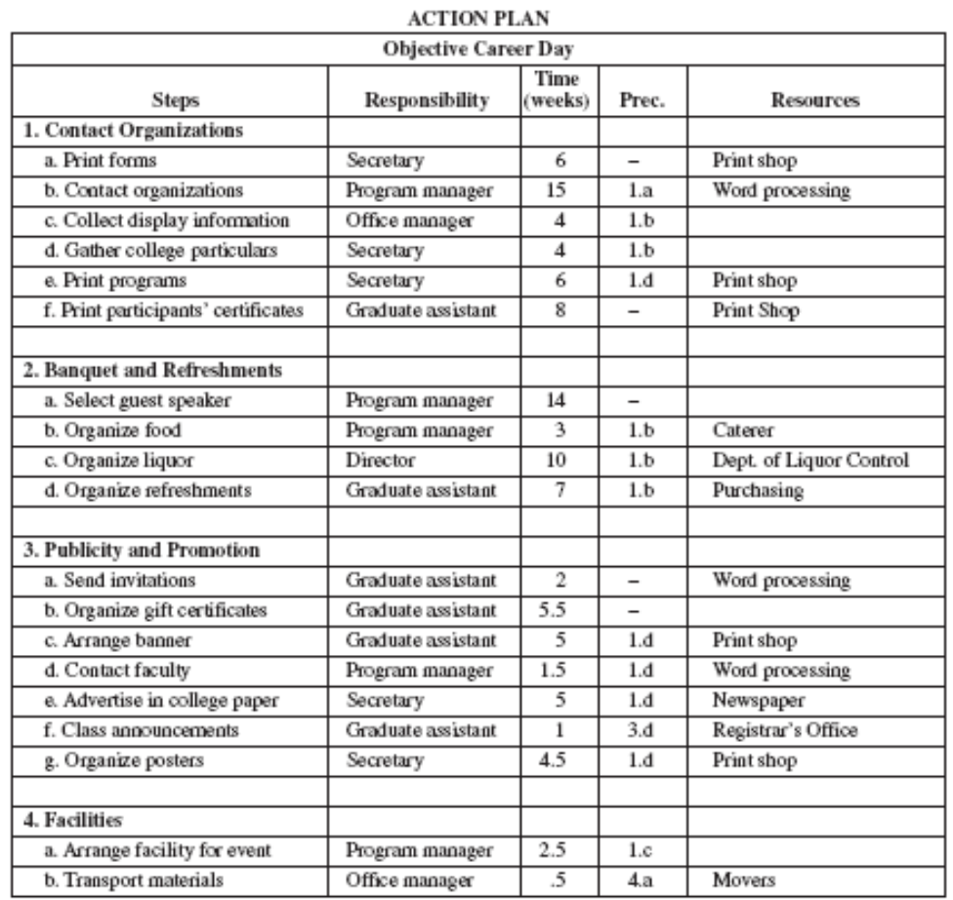
Career Day
Figure 6-3

Slide 27
Scheduling the Project
The Action Plan contains the basic information, Activity, Time, Person, Preceding Task / Activity (Predecessor)
MS Project is a Scheduling tool
  Control, Monitor, modify
  MS project is NOT a Planning Tool !

Slide 28
Linear Responsibility Charts
Ties each work package to someone
May also show interfaces between groups

Slide 29
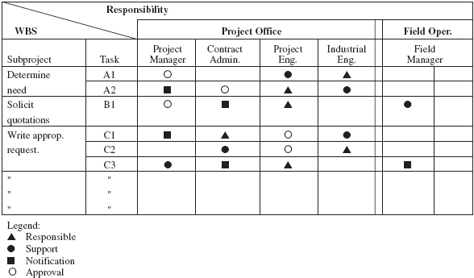
Sample Linear Responsibility Chart
Figure 6-7

Slide 30
Interface Coordination Through Integration Management
Managing a project requires a great deal of coordination
Projects typically draw from many parts of the organization as well as outsiders
All of these must be coordinated
The linear responsibility chart helps the project manager accomplish this

Slide 31
Integration Management
Multidisciplinary teams
Integration management
Interface coordination

Slide 32
Managing Projects by Phases and Phase-Gates
Break objectives into shorter term sub-objectives
Project life cycle used for component parts
Focus on specific, short-term output
Lots of feedback between disciplines

Slide 33
Success criteria for managing a software project
Time,
  delivering the project on time. Time/duration
Cost,
  keeping overall costs within budget.
Performance,
  Suitable quality product
  Maintain well-functioning development team, happy workers
Customer focus,
  Meeting the customer’s expectations. Customer satisfaction

Slide 34
Three strategies (approaches) for managing risk: Avoidance
Avoidance: plan or take a pre-emptive course of action to reduce the probability of occurrence of the risk.
  Example: Replace potentially defective components with bought-in components of known reliability.

Slide 35
Three strategies (approaches) for managing risk: Minimisation
Minimisation: take a pre-emptive course of action to soften the impact of the risk if it occurs.
  Example: Reorganise team so that there is more overlap of work and people therefore understand each other’s jobs and can back each other up if someone falls ill.

Slide 36
Three strategies (approaches) for managing risk: Contingency
Contingency plans: If the risk does occur, have a well-studied course of action to go through the aftermath.
  Example: In case of project cuts, prepare a briefing document for senior management showing how the project is making a very important contribution to the goals of the business.

Slide 37
Risk Analysis
Analyse risks related to tasks
  Schedule, costs, resource availability
Review Excel sheet
  Identify Risks under different categories
    What is the potential impact on the project?
  What is the probability of the risk occurring?
  How can the risk be got rid of (mitigated) ?
  Who is responsible for control and Monitoring?

